Slide 1
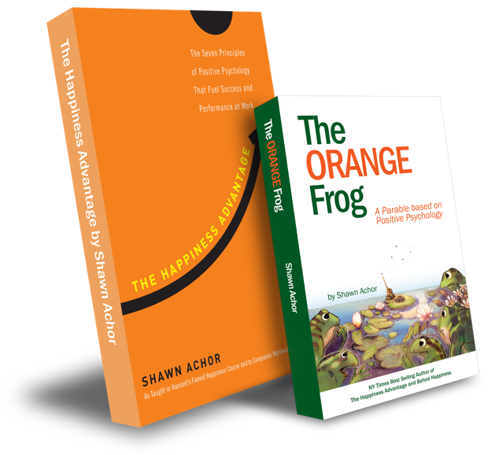
Conscious Acts
Of
Kindness

Slide 2
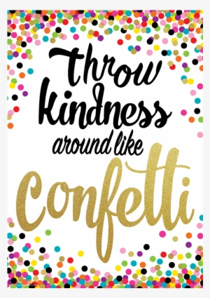
Week Two

Slide 3
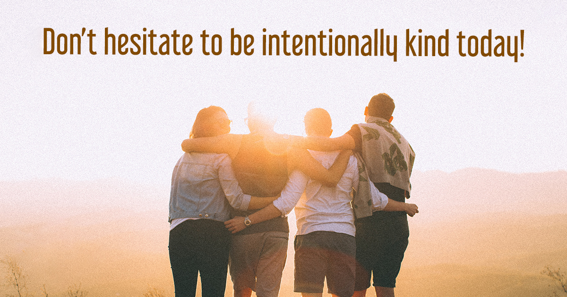
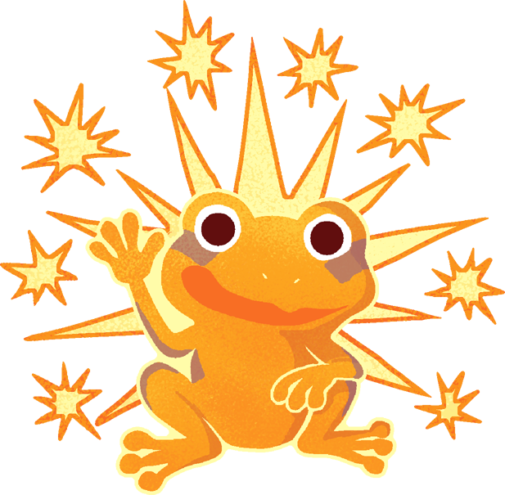
Conscious acts of Kindness
Learning Objective:
I can identify what it means to be intentional.
I will discuss the importance of strategically being kind to others.
Notes:
Standard:
Essential Concept and/or Skill: Communicate and work productively with others emphasizing collaboration and cultural awareness to produce quality work.
Interact positively as a team member.
Cooperate with others in a group setting.
Generate ideas with group members.
Are active listeners.
Read and understand information in a variety of forms.
Express ideas.
Skill:
Active listening, express ideas

Slide 4
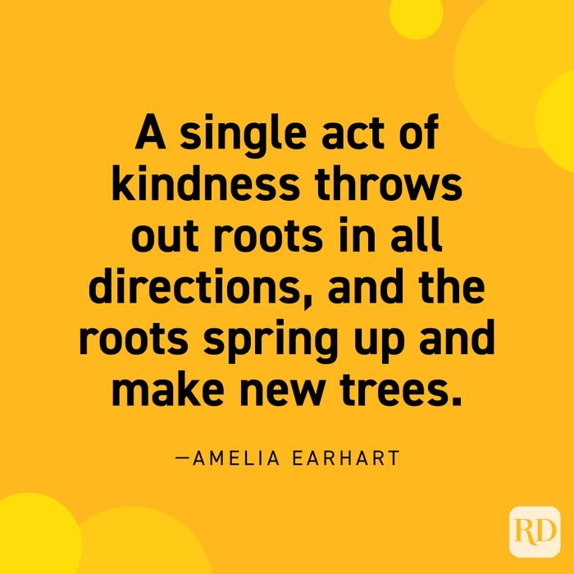
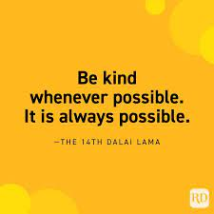
Skills
Relationship skills
Social awareness

Slide 5
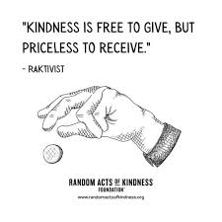
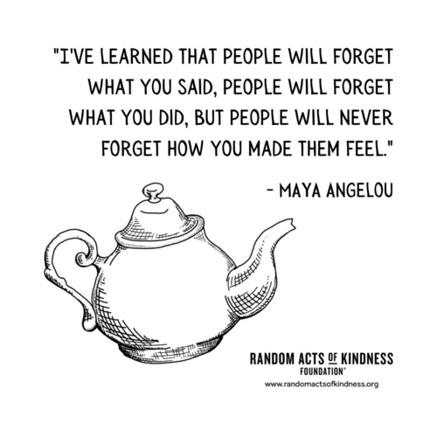
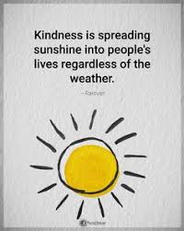
Questions
What kinds of things can bring happiness to others?
What are some ways you can make those around you happy?

Slide 6
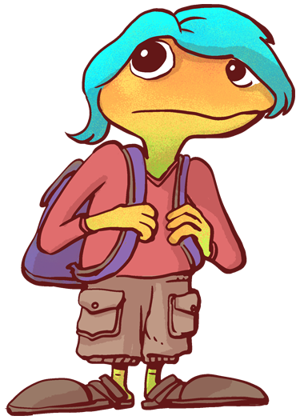
Thoughts
When we take the time to be kind to others, it can create a ripple effect. That means that when one person is kind, they in turn will be kind to someone else. Kindness towards others can help them to be kind further.

Slide 8
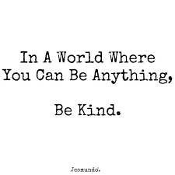
Activity
Today, we are going to try to figure out a way to be kind to someone else. We are going to take some time to decide who to be kind to; but then we are also going to decide what we can do to make them feel loved. Sometimes, figuring out how to be kind is just as important as deciding who we will be kind to.

Slide 9
